Slide 1





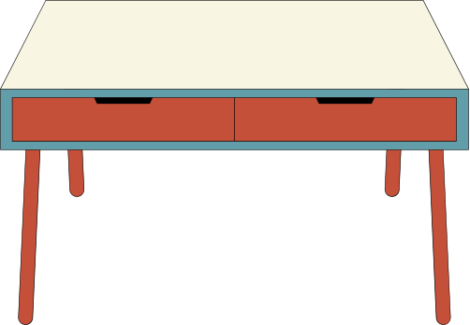

Department of AI & ML, SIT, Pune
1
MINI PROJECT PHASE 1
EDA/DPL
BOX OFFICE REVENUE PREDICTION USING IMDB DATASET
BOX OFFICE REVENUE PREDICTION USING IMDB DATASET
SNEH PATEL - 22070126113
SHUBH AGARWAL - 22070126108
SHREYASEE SHINDE - 22070126106

Slide 2



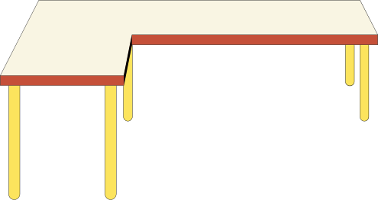
Department of AI & ML, SIT, Pune
2
PROBLEM STATEMENT
PROBLEM STATEMENT
Box Office Revenue Prediction:
Film production companies want to predict a movie's potential box office revenue based on pre-release information to optimize their marketing and distribution strategies. They seek to identify key factors that significantly influence a movie's box office performance.

Slide 3




OBJECTIVES
OBJECTIVES
Department of AI & ML, SIT, Pune
3
EXPLORATORY DATA ANALYSIS (EDA)
DATA-DRIVEN DECISION MAKING (DPL) MODEL
REPORTING AND VISUALIZATION
EXPLORATORY DATA ANALYSIS (EDA)
DATA-DRIVEN DECISION MAKING (DPL) MODEL
REPORTING AND VISUALIZATION
Identify factors that influence a movie's box office performance by analyzing correlations and trends.
Understand the relationships between variables like Votes, Gross, Movie Rating , and Stars.
Develop a predictive model that can estimate a movie's potential box office revenue based on pre-release information.
Train and validate the model to ensure accuracy.
Create reports summarizing factors influencing box office revenue and predictive models.
Generate visualizations to illustrate the relationships between factors and revenue.

Slide 4


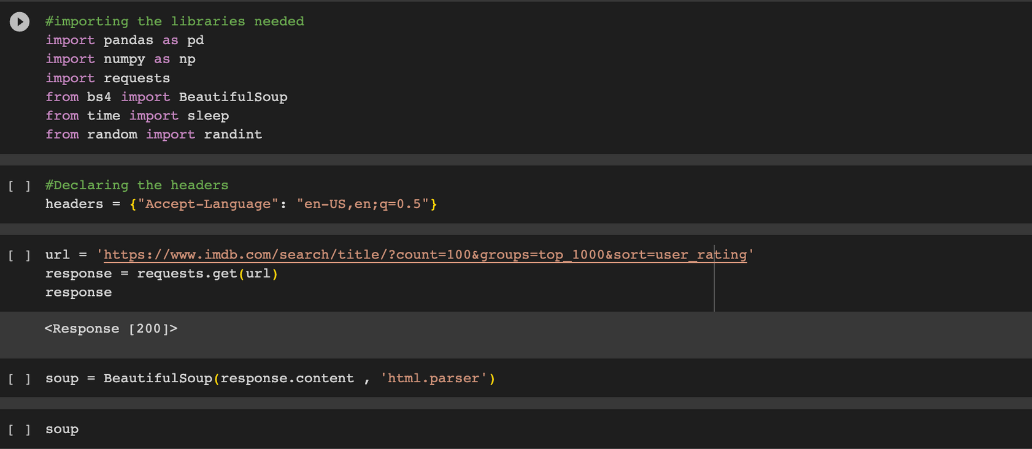

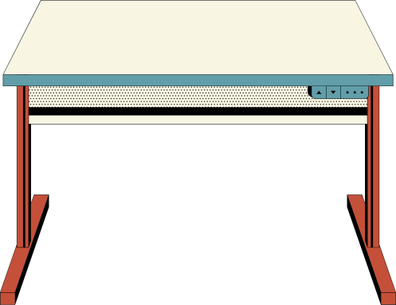

Department of AI & ML, SIT, Pune
4
DATA ACQUISITION
DATA ACQUISITION
Data was obtained by web scraping the website of IMDb's top-rated movie listings using one of the most famous library beautiful soup .

Slide 5
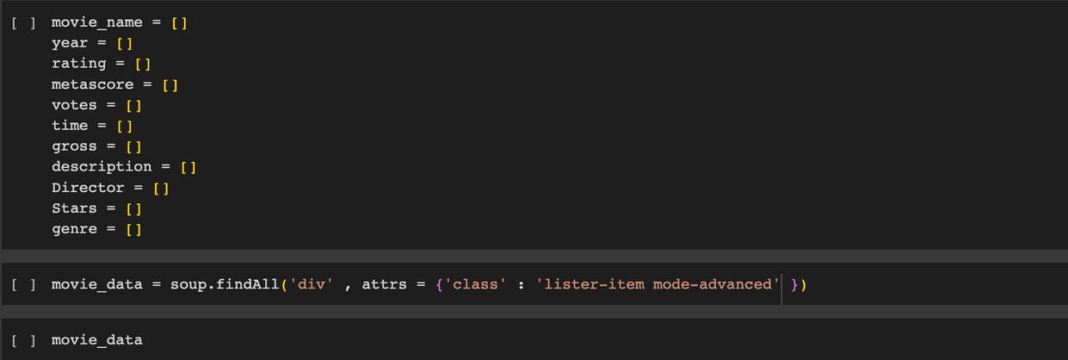
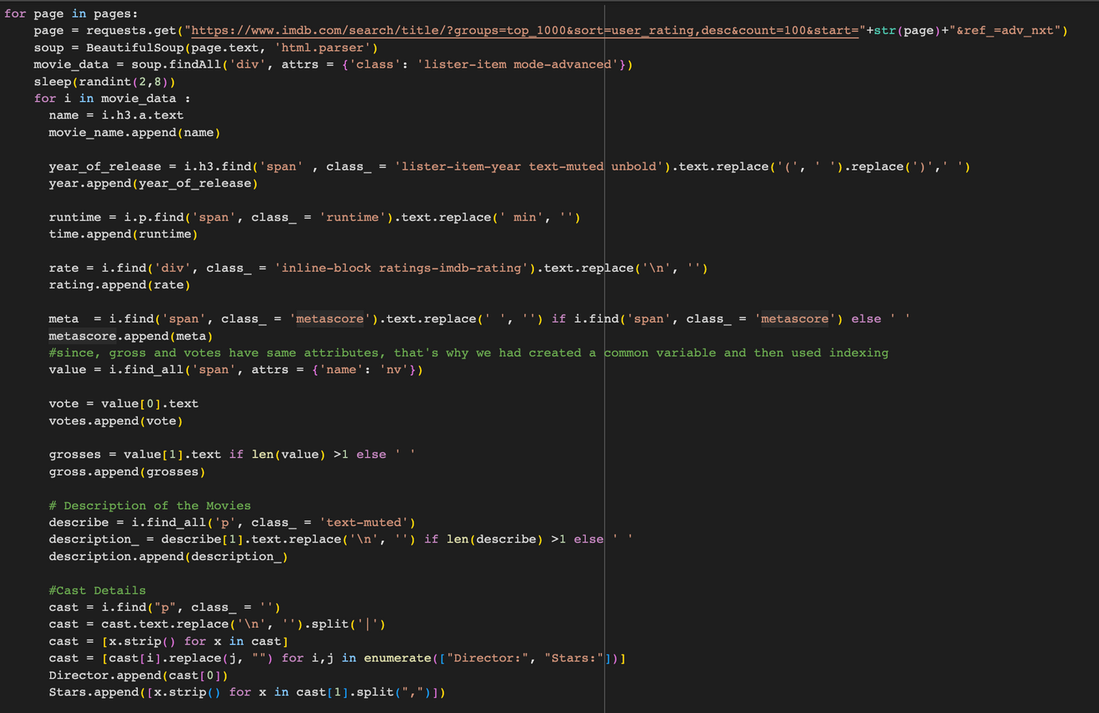
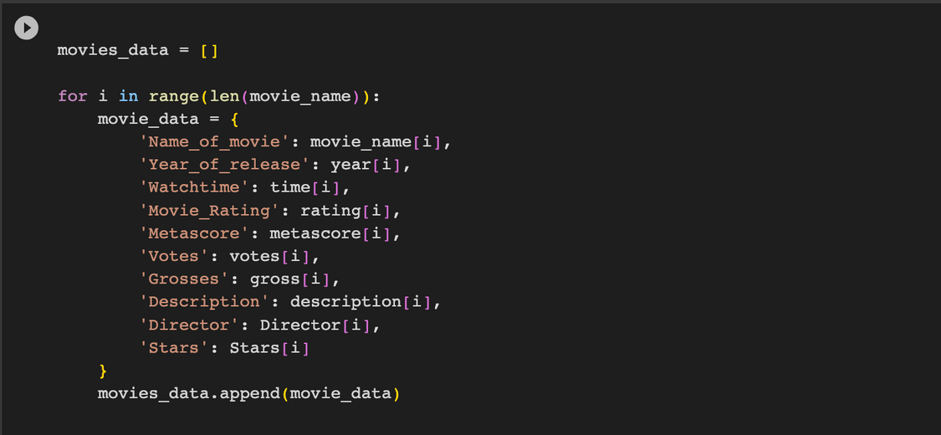
Department of AI & ML, SIT, Pune
5
DATA ACQUISITION
DATA ACQUISITION

Slide 6

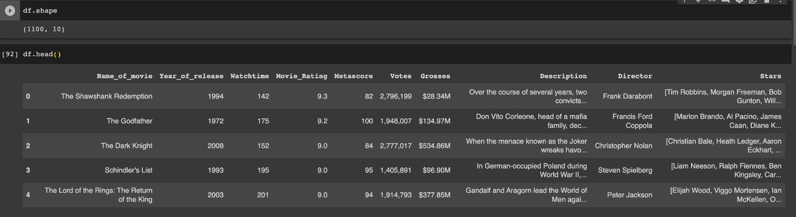

Department of AI & ML, SIT, Pune
DATA ACQUISITION
6
DATA ACQUISITION

Slide 7

Department of AI & ML, SIT, Pune
7
DATA
DESCRIPTION
DATA
DESCRIPTION
This dataset comprises of 1000 observations and 11 attributes, providing a rich mix of both numeric and text data. Notably, this dataset has been partially cleaned, and there are no missing values remaining and and was web scraped from IMDb's top-rated movie listings (https://www.imdb.com/search/title/?count=100&groups=top_1000&sort=user_rating) on 2nd September , 2023, by Shubh Agarwal, Sneh Patel, and Shreyasee Shinde.
Summarizing and providing an overview of a dataset's key characteristics and attributes.

Slide 8
Department of AI & ML, SIT, Pune
ATTRIBUTES / VARIABLES
8
ATTRIBUTES / VARIABLES
1
6
Votes
Name_of_movie
2
Year_of_release
7
Grosses
3
Watchtime
8
Description
4
Movie_Rating
9
Director
5
Metascore
10
Stars

Slide 9
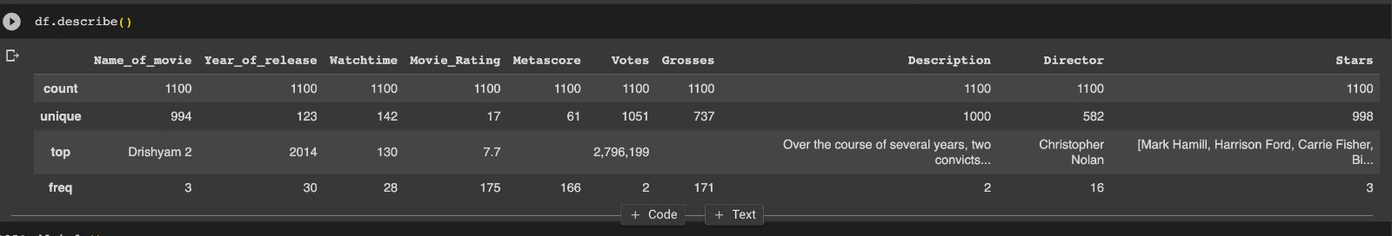
Department of AI & ML, SIT, Pune
9

Slide 10
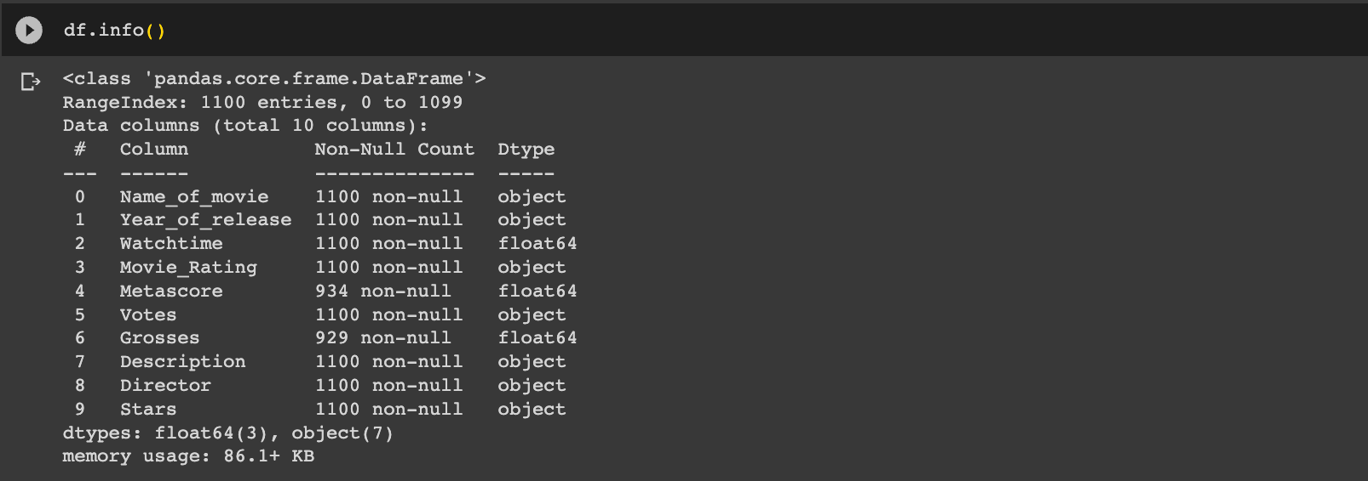
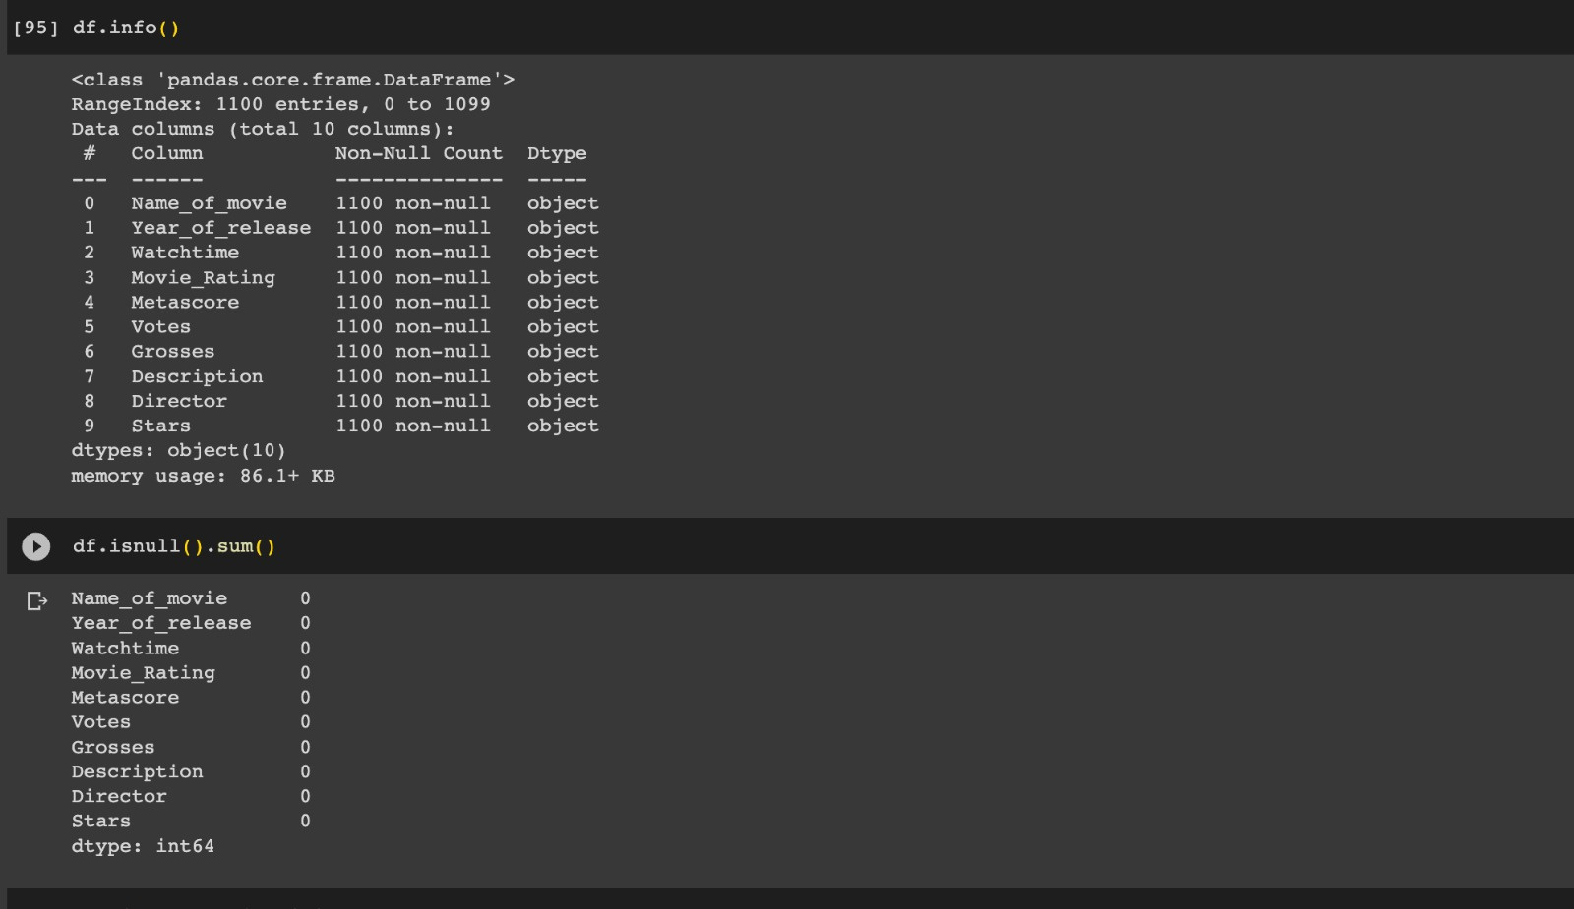
DATA DESCRIPTION
DATA DESCRIPTION
Department of AI & ML, SIT, Pune
10

Slide 11
Department of AI & ML, SIT, Pune
11
THANK YOU!
THANK YOU!

